Slide 1
Module – 1
Introduction to Linux & Shell Scripting

Slide 2
Agenda
Introduction to Linux
Brief history about Linux
Linux File System
Common Linux Commands
Demo
Tomorrow’s plan & pre-requisites

Slide 3
Operating Systems
Software
– Collection of instructions that control the tasks a
computer performs
– Can be changed without disassembling the
computer and rewiring
Application
– Software program that provides service for
computer user
– Cannot act without “permission” from
operating systemx

Slide 4
Operating Systems
Operating system (OS)
– Software that helps other programs control
computer hardware and interact with users
– All computers need an OS
– Popular OSes include Windows, Linux, Mac OSX

Slide 5
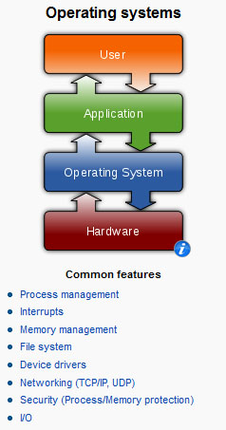
What is Linux?
It’s an Operating System

Slide 6
Operating System Functions
Initialize computer hardware
Allocate system resources to programs
Keep track of multiple programs running at
same time
Provide organized method for all programs to
use system devices

Slide 7
Before Linux
• In 80’s, Microsoft’s DOS was the dominated OS
for PC
• Apple MAC was better, but expensive
• UNIX was much better, but much, much more
expensive. Only for minicomputer for
commercial applications
• People was looking for a UNIX based system,
which is cheaper and can run on PC
• Both DOS, MAC and UNIX were proprietary, i.e.,
the source code of their kernel is protected
• No modification is possible without paying high
license fees

Slide 8
Linux Arrived
• Inspired by the UNIX OS, the Linux kernel was
developed as a clone of UNIX
• GNU was started in 1984 with a mission to
develop a free UNIX-like OS
• Linux was the best fit as the kernel for the GNU
Project
• Linux kernel was passed onto many interested
developers throughout the Internet
• Linux today is a result of efforts of Linus Torvalds
and thousands of individuals, in 1991

Slide 9
Linux Arrived
• Linux is basically a kernel, it was combined with
the various software and compilers from GNU
Project to form an OS, called GNU/Linux
• Linux is a full-fledged OS available in the form of
various Linux Distributions
• RedHat, Fedora, CentOS, SuSE, Ubuntu, Debian are examples of Linux distros
• Linux is supported by big names as Amazon, IBM, Google, Sun, Novell, Oracle, HP, Dell, and many more

Slide 10

Linux Has Many Distributions

Slide 11
Linux File System
The *Nix (Unix or Linux) file system is a hierarchical directory structure
The structure resembles an upside down tree
Directories are collections of files and other directories. The structure is recursive with many levels.
Every directory has a parent except for the root directory.
Many directories have children directories.
Unlike Windows, with multiple drives and multiple file systems, a *Nix system only has ONE file system.
The Linux Standard Base (LSB) specifies the structure of a Linux file system.

Slide 12
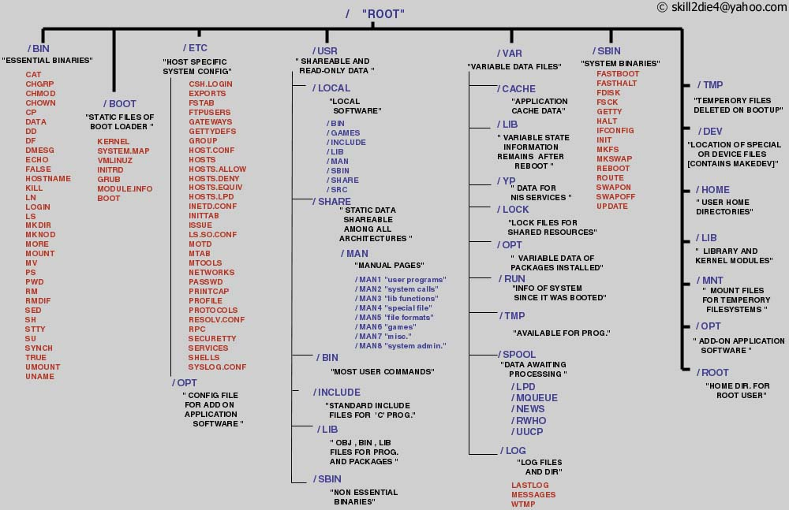
Linux File System

Slide 13
You need help?
The Linux equivalent of HELP is man (manual)
Use man -k <keyword> to find all commands with that keyword
Use man <command> to display help for that command
Output is presented a page at a time. Use b for to scroll backward, f or a space to scroll forward and q to quit

Slide 14
The Linux System
User commands includes executable programs and scripts
The shell interprets user commands. It is responsible for finding the commands and starting their execution. Several different shells are available. Bash is popular,
The kernel manages the hardware resources for the rest of the system.

Slide 15
Linux File System Basics
Linux files are stored in a single rooted, hierarchical file system
Data files are stored in directories (folders)
Directories may be nested as deep as needed
Directories
/
root
etc
home
usr
passwd
inittab
User home directories
neale
scully
marty
a
b
Data files

Slide 16
Naming Files
Files are named by
naming each containing directory
starting at the root
This is known as the pathname
/
etc
home
usr
passwd
inittab
/etc/passwd
neale
scully
marty
a
b
/home/neale/b

Slide 17
The Current Directory
One directory is designated the current working directory
if you omit the leading / then path name is relative to the current working directory
Use pwd to find out where you are
/
etc
home
usr
passwd
inittab
neale
scully
marty
Current working directory
a
doc
doc/letter
./doc/letter
/home/neale/doc/letter
letter

Slide 18
Some Special File Names
Some file names are special:
/ The root directory (not to be confused with the root user)
. The current directory
.. The parent (previous) directory
~ My home directory
Examples:
./a same as a
../jane/x go up one level then look in directory jane for x

Slide 19
Special Files
/home - all users’ home directories are stored here
/bin, /usr/bin - system commands
/sbin, /usr/sbin - commands used by sysadmins
/etc - all sorts of configuration files
/var - logs, spool directories etc.
/dev - device files
/proc - special system files

Slide 20
Linux Command Basics
To execute a command, type its name and arguments at the command line
ls -l /etc
Command name
Arguments
Options
(flags)

Slide 21
Standard Files
UNIX concept of “standard files”
standard input (where a command gets its input) - default is the terminal
standard output (where a command writes it output) - default is the terminal
standard error (where a command writes error messages) - default is the terminal

Slide 22
Redirecting Output
The output of a command may be sent (piped) to a file:
ls -l >output
“>” is used to specify the output file

Slide 23
Redirecting Input
The input of a command may come (be piped) from a file:
wc <input
“<” is used to specify the input file

Slide 24
Connecting commands with Pipes
Not as powerful as CMS Pipes but the same principle
The output of one command can become the input of another:
Like CMS Pipes, “|” is used to separate stages
ps aux | grep netscape | wc -l
The output of the ps command is sent to grep
wc takes this input and counts the lines its output going to the console
grep takes input and searches for “netscape” passing these lines to wc

Slide 25
Command Options
Command options allow you to control a command to a certain degree
Conventions:
Usually being with a single dash and are a single letter (“-l”)
Sometimes have double dashes followed by a keyword (“--help”)
Sometimes follow no pattern at all

Slide 26
Common Commands
pwd - print (display) the working directory
cd <dir> - change the current working directory to dir
ls - list the files in the current working directory
ls -l - list the files in the current working directory in long format

Slide 27
Some important commands in Linux
ls, Give a listing of the current directory. Try also ls -l
cp, Copy file from source to destination
mv, Move file from source to destination. If both are the same directory, the file is renamed
vi, Edit a file. vi is one of the most powerful text editors
chmod, Change file permissions
mkdir, rmdir Make/Remove a directory
cd, Change directory
rm, Remove a file. Can also remove directory tree
man ls, Get help for ls. All commands have help

Slide 28
Networking
telnet
Log into a remote host machine.
ping
See if a remote host is up.
ftp
Transfer files using the File Transfer Protocol.
who
See who else is logged in.
talk
Talk to someone else who is current logged in.

Slide 29
Manipulating Files
cat
Concatenate program. Can be used to concatenate multiple files together into a single file, or, much more frequently, to send the contents of a file to the terminal for viewing.
more
Scroll through a file page by page. Very useful when viewing large files. Works even with files that are too big to be opened by a text editor.
less
A version of more with more features.
head
View the head (top) of a file. You can control how many lines to view.
tail
View the tail (bottom) of a file. You can control how many lines to view. You can also use tail to view a growing file.
wc
Count words, lines and/or characters in one or more files.
tr
Substitute one character for another. Also useful for deleting characters.
sort
Sort the lines in a file alphabetically or numerically.
uniq
Remove duplicated lines in a file.
cut
Remove sections from each line of a file or files.

Slide 30
Manipulating Files
fold
Wrap each input line to fit in a specified width.
grep
Filter a file for lines matching a specified pattern. Can also be reversed to print out lines that don't match the specified pattern.
gzip (gunzip)
Compress (uncompress) a file.
tar
Archive or unarchive an entire directory into a single file.
pico
Run the pico text editor (good for beginners).
emacs
Run the Emacs text editor (good for experts).

Slide 31
File Commands
cp <fromfile> <tofile>
Copy from the <fromfile> to the <tofile>
mv <fromfile> <tofile>
Move/rename the <fromfile> to the <tofile>
rm <file>
Remove the file named <file>
mkdir <newdir>
Make a new directory called <newdir>
rmdir <dir>
Remove an (empty) directory

Slide 32
More Commands
who
List who is currently logged on to the system
whoami
Report what user you are logged on as
ps
List your processes on the system
ps aux
List all the processes on the system
echo “A string to be echoed”
Echo a string (or list of arguments) to the terminal

Slide 33
More Commands
alias - used to tailor commands:
alias erase=rm
alias grep=”grep -i”
ar - Maintain archive libraries: a collection of files (usually object files which may be linked to a program, like a CMS TXTLIB)
ar -t libgdbm.a
__.SYMDEF
dbmopen.o

Slide 34
More Commands
awk - a file processing language that is well suited to data manipulation and retrieval of information from text files
chown - sets the user ID (UID) to owner for the files and directories named by pathname arguments. This command is useful when from test to production
chown -R apache:httpd /usr/local/apache

Slide 35
More Commands
diff - attempts to determine the minimal set of changes needed to convert a file specified by the first argument into the file specified by the second argument
find - Searches a given file hierarchy specified by path, finding files that match the criteria given by expression

Slide 36
More Commands
grep - Searches files for one or more pattern arguments. It does plain string, basic regular expression, and extended regular expression searching
find ./ -name "*.c" | xargs grep -i "fork"
In this example, we look for files with an extension “c” (that is, C source files). The filenames we
find are passed to the xargs command which takes these names and constructs a command line
of the form: grep -i fork <file.1>…<file.n>. This command will search the files for the
occurrence of the string “fork”. The “-i” flag makes the search case insensitve.

Slide 37
More Commands
kill - sends a signal to a process or process group
You can only kill your own processes unless you are root
UID PID PPID C STIME TTY TIME CMD
root 6715 6692 2 14:34 ttyp0 00:00:00 sleep 10h
root 6716 6692 0 14:34 ttyp0 00:00:00 ps -ef
[root@penguinvm log]# kill 6715
[1]+ Terminated sleep 10h

Slide 38
More Commands
make - helps you manage projects containing a set of interdependent files (e.g. a program with many source and object files; a document built from source files; macro files)
make keeps all such files up to date with one another: If one file changes, make updates all the other files that depend on the changed file
Roughly the equivalent of VMFBLD

Slide 39
More Commands
sed - applies a set of editing subcommands contained in a script to each argument input file
find ./ -name "*.c,v" | sed ’s/,v//g’ | xargs grep "PATH"
This finds all files in the current and subsequent directories with an extension of c,v. sed then strips the ,v off the results of the find command. xargs then uses the results of sed and builds a grep command which searches for occurrences of the word PATH in the C source files.

Slide 40
More Commands
tar - manipulates archives
An archive is a single file that contains the complete contents of a set of other files; an archive preserves the directory hierarchy that contained the original files. Similary to a VMARC file
tar -tzf imap-4.7.tar.gz
imap-4.7/
imap-4.7/src/
imap-4.7/src/c-client/
imap-4.7/src/c-client/env.h
imap-4.7/src/c-client/fs.h

Slide 41
Shells
An interface between the Linux system and the user
Used to call commands and programs
An interpreter
Powerful programming language
“Shell scripts” = .bat .cmd EXEC REXX
Many available (bsh; ksh; csh; bash; tcsh)

Slide 42
Another definition of a Shell
A shell is any program that takes input from the user, translates it into instructions that the operating system can understand, and conveys the operating system's output back to the user.
i.e. Any User Interface
Character Based v Graphics Based

Slide 43
Why Do I Care About The Shell?
Shell is Not Integral Part of OS
UNIX Among First to Separate
Compare to MS-DOS, Mac, Win95, VM/CMS
GUI is NOT Required
Default Shell Can Be Configured
chsh -s /bin/bash
/etc/passwd
Helps To Customize Environment

Slide 44
Shell Scripts
#!/bin/bash
while
true
do
cat somefile > /dev/null
echo .
done
/* */
do forever
‘PIPE < SOME FILE | hole’
say ‘.’
end

Slide 45
Switching Users
su <accountname>
switch user accounts. You will be prompted for a password. When this command completes, you will be logged into the new account. Type exit to return to the previous account
su
Switch to the root user account. Do not do this lightly
Note: The root user does not need to enter a password when switching users. It may become any user desired. This is part of the power of the root account.

Slide 46
Environment Variables
Environment variables are global settings that control the function of the shell and other Linux programs. They are sometimes referred to global shell variables.
Setting:
VAR=/home/fred/doc
export TERM=ansi
SYSTEMNAME=`uname -n`
Similar to GLOBALV SET … in CMS

Slide 47
Environment Variables
Using Environment Variables:
echo $VAR
cd $VAR
cd $HOME
echo “You are running on $SYSTEMNAME”
Displaying - use the following commands:
set (displays local & env. Vars)
export
Vars can be retrieved by a script or a program

Slide 48
Some Important Environment Variables
HOME
Your home directory (often be abbreviated as “~”)
TERM
The type of terminal you are running (for example vt100, xterm, and ansi)
PWD
Current working directory
PATH
List of directories to search for commands

Slide 49
PATH Environment Variable
Controls where commands are found
PATH is a list of directory pathnames separated by colons. For example:
PATH=/bin:/usr/bin:/usr/X11R6/bin:/usr/local/bin:/home/scully/bin
If a command does not contain a slash, the shell tries finding the command in each directory in PATH. The first match is the command that will run

Slide 50
PATH Environment Variable
Similar to setting the CMS search order
Usually set in /etc/profile (like the SYSPROF EXEC)
Often modified in ~/.profile (like the PROFILE EXEC)

Slide 51
File Permissions
Every file
Is owned by someone
Belongs to a group
Has certain access permissions for owner, group, and others
Default permissions determined by umask

Slide 52
File Permissions
Every user:
Has a uid (login name), gid (login group) and membership of a "groups" list:
The uid is who you are (name and number)
The gid is your initial “login group” you normally belong to
The groups list is the file groups you can access via group permissions

Slide 53
File Permissions
Linux provides three kinds of permissions:
Read - users with read permission may read the file or list the directory
Write - users with write permission may write to the file or new files to the directory
Execute - users with execute permission may execute the file or lookup a specific file within a directory

Slide 54
File Permissions
The long version of a file listing (ls -l) will display the file permissions:
-rwxrwxr-x 1 rvdheij rvdheij 5224 Dec 30 03:22 hello
-rw-rw-r-- 1 rvdheij rvdheij 221 Dec 30 03:59 hello.c
-rw-rw-r-- 1 rvdheij rvdheij 1514 Dec 30 03:59 hello.s
drwxrwxr-x 7 rvdheij rvdheij 1024 Dec 31 14:52 posixuft
Permissions
Group
Owner

Slide 55
Interpreting File Permissions
-rwxrwxrwx
Other permissions
Group permissions
Owner permissions
Directory flag (d=directory; l=link)

Slide 56
Changing File Permissions
Use the chmod command to change file permissions
The permissions are encoded as an octal number
chmod 755 file # Owner=rwx Group=r-x Other=r-x
chmod 500 file2 # Owner=r-x Group=--- Other=---
chmod 644 file3 # Owner=rw- Group=r-- Other=r--
chmod +x file # Add execute permission to file for all
chmod o-r file # Remove read permission for others
chmod a+w file # Add write permission for everyone

Slide 57
Links?
Links are references to files (aliases)
Two forms:
Hard
Symbolic
Can point to files on different physical devices
Delete of original leaves link
Delete of link leaves original
Can be created for directories
Create using ln command

Slide 58
Editors
People are fanatical about their editor
Several choices available:
vi Standard UNIX editor
the XEDIT-like editor
xedit X windows text editor
emacs Extensible, Customizable Self- Documenting Display Editor
pico Simple display-oriented text editor
nedit X windows Motif text editor

Slide 59
Linux Device Handling
Devices are the way linux talks to the world
Devices are special files in the /dev directory (try ls /dev)
/dev/ttyx TTY devices
/dev/hdb IDE hard drive
/dev/hdb1 Partition 1 on the IDE hard drive
/dev/mnda VM Minidisk
/dev/dda Channel Attached DASD
/dev/dda1 Partition 1 on DASD
/dev/null The null device (“hole”)
/dev/zero An endless stream of zeroes
/dev/mouse Link to mouse (not /390)

Slide 60
Devices and Drivers
Each /dev file has a major and minor number
Major defines the device type
Minor defines device within that type
Drivers register a device type
brw-r--r-- 1 root root 64, 0 Jun 1 1999 /dev/mnda
crw-r--r-- 1 root root 5, 0 Jan 5 09:18 /dev/tty
Device Type:
b - block
c - character
Major no.
Minor no.

Slide 61
Special Files - /proc
Information about internal Linux processes are accessible to users via the /proc file system (in memory)
cat /proc/cpuinfo
vendor_id : IBM/S390
# processors : 1
bogomips per cpu: 86.83
processor 0: version = FF, identification = 045226, machine = 9672

Slide 62
File Systems
Linux supports many different types
Most commonly, ext2fs
Filenames of 255 characters
File sizes up to 2GB
Theoretical limit 4TB
Derived from extfs
Highly reliable and high performer

Slide 63
File Systems
Other file systems:
sysv - SCO/Xenix
ufs - SunOS/BSD
vfat - Win9x
msdos - MS-DOS/Win
umsdos - Linux/DOS
ntfs - WinNT (r/o)
hpfs - OS/2 (r/o)
Other File systems:
iso9660 (CD-ROM)
nfs - NFS
coda - NFS-like
ncp - Novell
smb - LANManager etc

Slide 64
File Systems
mount
Mounts a file system that lives on a device to the main file tree
Start at Root file system
Mount to root
Mount to points currently mounted to root
/etc/fstab used to establish boot time mounting

Slide 65
Virtual File System
VFS is designed to present a consistent view of data as stored on hardware
Almost all hardware devices are represented using a generic interface
VFS goes further, allowing the sysadmin to mount any of a set of logical file systems on any physical device

Slide 66
Virtual File System
Logical file systems promote compatibility with other operating system standards permitting developers to implement file systems with different policies
VFS abstracts details of physical device and logical file system allowing processes to access files using a common interface, without knowing what physical or logical system the file resides on

Slide 67
Virtual File System
Analogous to CMS:
SFS
Minidisks
Two different designs
Common/transparent access

Slide 68
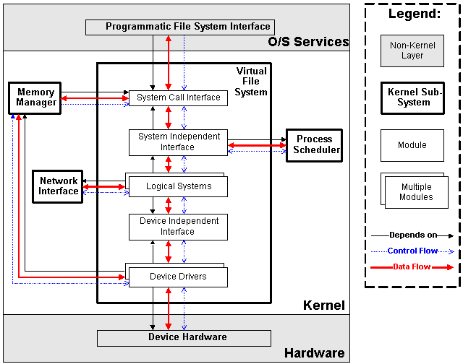

Slide 69
Processes
Processes are created in a hierarchical structure whose depth is limited only by the virtual memory available to the virtual machine
A process may control the execution of any of its descendants by suspending or resuming it, altering its relative priority, or even terminating it
Termination of a process by default causes termination of all its descendants; termination of the root process causes termination of the session
Linux assigns a process ID (PID) to the process

Slide 70
Processes
Foreground
When a command is executed from the prompt and runs to completion at which time the prompt returns is said to run in the foreground
Background
When a command is executed from the prompt with the token “&” at the end of the command line, the prompt immediately returns while the command continues is said to run in the background

Slide 71
Processes
Daemons
Background processes for system administration are referred to as “daemons”
These processes are usually started during the boot process
The processes are not assigned any terminals
UID PID PPID C STIME TTY TIME CMD
root 5 1 0 1999 ? 00:00:14 [kswapd]
bin 254 1 0 1999 ? 00:00:00 [portmap]
root 307 1 0 1999 ? 00:00:23 syslogd -m 0
root 350 1 0 1999 ? 00:00:34 httpd

Slide 72
Processes
& causes process to be run in “background”
[root@penguinvm log]# sleep 10h &
[1] 6718
[root@penguinvm log]# ps -ef
UID PID PPID C STIME TTY TIME CMD
root 6718 6692 0 14:49 ttyp0 00:00:00 sleep 10h
Job Number
Process ID (ID)
Parent Process ID

Slide 73
Processes - UID & GID
Real UID
At process creation, the real UID identifies the user who has created the process
Real GID
At process creation, the real GID identifies the current connect group of the user for which the process was created

Slide 74
Processes - UID & GID
Effective UID
The effective UID is used to determine owner access privileges of a process.
Normally the same as the real UID. It is possible for a program to have a special flag set that, when this program is executed, changes the effective UID of the process to the UID of the owner of the program.
A program with this special flag set is said to be a set-user-ID program (SUID). This feature provides additional permissions to users while the SUID program is being executed.

Slide 75
Processes - UID & GID
Effective GID
Each process also has an effective group
The effective GID is used to determine group access privileges of a process
Normally the same as the real GID. A program can have a special flag set that, when this program is executed, changes the effective GID of the process to the GID of the owner of this program
A program with this special flag set is said to be a set-group-ID program (SGID). Like the SUID feature, this provides additional permission to users while the set-group-ID program is being executed

Slide 76
Processes - Process Groups
Each process belongs to a process group
A process group is a collection of one or more processes
Each process group has a unique process group ID
It is possible to send a signal to every process in the group just by sending the signal to the process group leader
Each time the shell creates a process to run an application, the process is placed into a new process group
When an application spawns new processes, these are members of the same process group as the parent

Slide 77
Processes - PID
PID
A process ID is a unique identifier assigned to a process while it runs
Each time you run a process, it has a different PID (it takes a long time for a PID to be reused by the system)
You can use the PID to track the status of a process with the ps command or the jobs command, or to end a process with the kill command

Slide 78
Processes - PGID
PGID
Each process in a process group shares a process group ID (PGID), which is the same as the PID of the first process in the process group
This ID is used for signaling-related processes
If a command starts just one process, its PID and PGID are the same

Slide 79
Processes - PPID
PPID
A process that creates a new process is called a parent process; the new process is called a child process
The parent process (PPID) becomes associated with the new child process when it is created
The PPID is not used for job control

Slide 80
Security Guidelines
Take Care With Passwords
Use good ones (motherhood statement)
Don't Use Real Words
Make Sure They Are Not Easily Guessed
Use Combinations Of Upper and Lower Case, Numbers, Punctuation
One Method: Take first letter of a sentence or book title, insert numbers and punctuation.

Slide 81
Security Guidelines
Take care of passwords (continued)
Use Shadow Passwords
Allows encrypted passwords to be in a file that is not world readable
Use Password Aging
Requires shadow passwords

Slide 82
Security Guidelines
Restrict Superuser Access
Restrict where root can log in from
/etc/securetty restricts root access to devices listed
Use wheel group to restrict who can su to root
Put users who can su to root in wheel group in /etc/group file.

Slide 83
Security Guidelines
Use groups to allow access to files that must be shared
Otherwise users will set world permission
Be careful with SUID and SGID
Avoid setting executables to SUID root
Wrap SUID root wrapper around programs if they must be run SUID root
Create special accounts for programs that must run with higher permissions

Slide 84
Security - Important Files
/etc/passwd - password file
/etc/shpasswd - shadow password file
/etc/group -lists groups and users contained in groups
/etc/services - lists network services and their ports
/etc/ftpusers - contains list of accounts that cannot use ftp
/etc/hosts.equiv - generic list of remote users
~/.rhosts - list of remote users for a specific account
/etc/hosts - host definition list
/etc/hosts.lpd - hosts who can use remote printing
/etc/hosts.allow - lists services that remote users are allowed to use
/etc/hosts.deny - lists services tthat remote users are not allowed to use
/etc/nologin - no login message that also disables logins
/etc/securetty - lists legal terminals for root to login from
/etc/exports - lists locations that can be remotely accessed via NFS
/etc/syslog.conf - configures the syslog facility
/etc/inetd.conf - configures inetd

